Slide 1

First Selenium Script

Slide 2
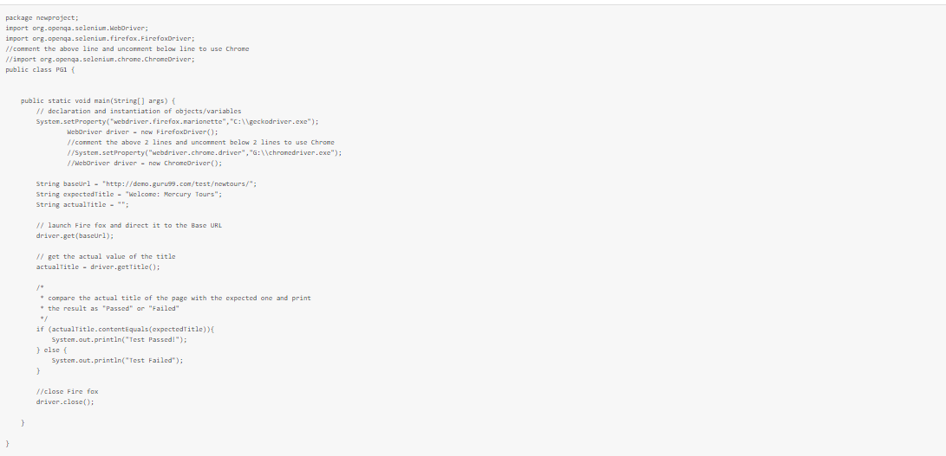
Sample Selenium Java Script

Slide 3
Code in Detail

Slide 4
1.Import Packages
To get started, you need to import following two packages:
org.openqa.selenium.*- contains the WebDriver class needed to instantiate a new browser loaded with a specific driver
org.openqa.selenium.firefox.FirefoxDriver - contains the FirefoxDriver class needed to instantiate a Firefox-specific driver onto the browser instantiated by the WebDriver class

Slide 5
Creating Instances of Objects and Variables
WebDriver driver=new FirefoxDriver();
It will launch Firefox browser without any extensions.
WebDriver driver=new ChromeDriver();
It will launch Chrome browser without any extensions

Slide 6
Opening a Browser Session
Driver.get(BaseURL);
It will open the specified URL(https://www.google.com) in the new browser session

Slide 7
Retrieve Actual Page Title
getTitle() function in the example shown is used to get the Title of the webpage.
actualTitle=driver.getTitle();

Slide 8
Compare the Expected and Actual Values
Simple if-else concept of Java is used to compare the actual title with the expected one.
if (actualTitle.contentEquals(expectedTitle))
{ System.out.println("Test Passed!");
}
else
{ System.out.println("Test Failed"); }

Slide 9
Closing the Brower Session
close() method in the example is used to terminate the current browser session.
driver.close();

Slide 10
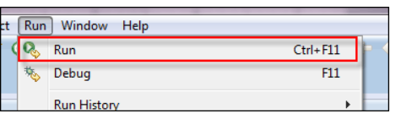
Running the Created Test
There are many ways to run the Script.
1.On Eclipse's menu bar, click Run > Run.
2.Press Ctrl+F11 to run the entire code.

Slide 11
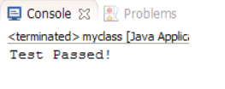
Checking the Result
The result will be printed in the Console Pane.
If the actual and expected results matches then it will print Test Passed! Else Test Failed!

